Slide 1
OBJECTIVE
To perform data analysis and visualization on Covid-19 data across the globe using ETL tools.
To extract the meaningful information from the dataset which will help in taking quick and informed decision which will help in preventing further spread of COVID-19

Slide 2
TECHNOLOGIES USED
SQL Server Integration Services (SSIS)
Spark
Azure Cloud Services
Azure SQL Database
Azure Blob Storage
Azure Data Factory
Azure Databricks
Power BI

Slide 3
CAPABILITIES
S.No. | KOs | FUNCTIONALITY | RELATED QUESTIONS
1 | Cleaning and transforming data for processing | SSIS | 2
2 | Extract , Transform & Load data in SSIS
3 | Transform data with Dataflow Operations & control flow operations
4 | Configure and deploy SSIS package
5 | Provisioning and deploying and relational database in Azure Cloud Service | Azure | 1,3,4,5,6,7,8,9,10,11
6 | Using query relational data in Azure using Data Factory
7 | Data storage and processing data in Azure Blob Storage
8 | Executing SSIS packages in Azure Data Bricks, Azure Synapse Analytics
9 | Connect to Azure SQL Database and creating data models in Power BI | Power BI | 12,13,14,15,16,17,18,19
10 | Using DAX to create calculated columns , measures
11 | Create effective reports , dashboards , deploy and publish in power BI

Slide 4
SCHEMA REPRESENTATION
Vacc
Location
Iso_code
Date
Daily_vaccinations
People_fully_vaccinated
isoDate
Population
Iso_code
Date
Critical_patients
Hosp_patients
New_tests
Positive_rate
population
Aged_65_older
isoDate
ACD
Iso_code
Continent
Location
Date
New_cases
New_deaths
Iso_date

Slide 5
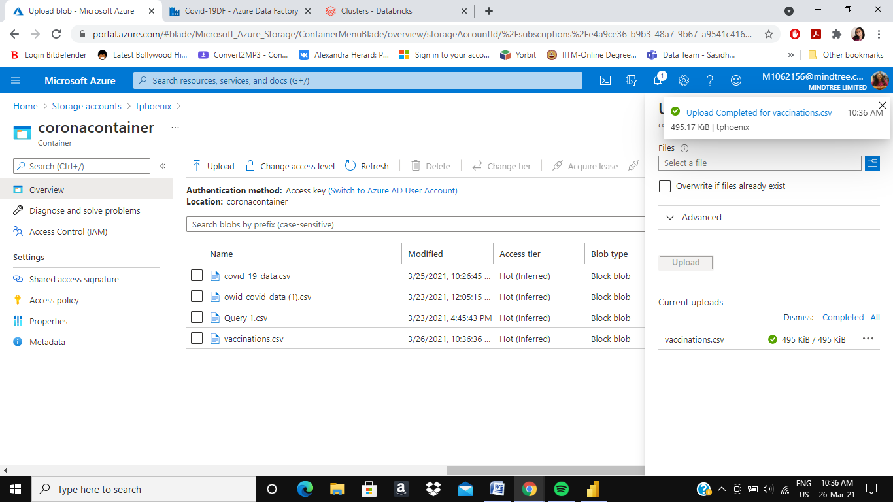
Problem Statements
Inserting the dataset in the Storage Container in Azure

Slide 6
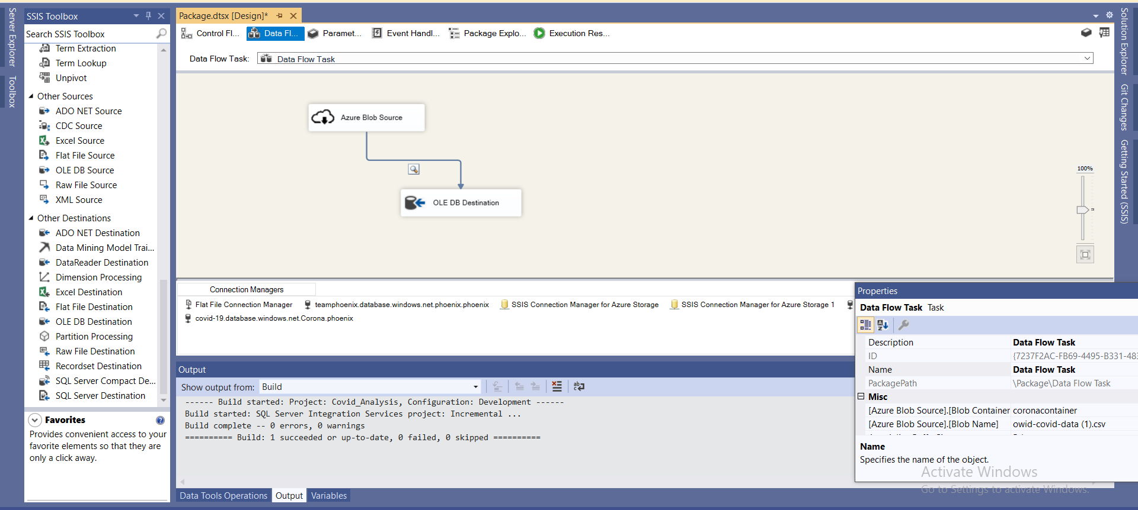
2. Taking dataset from the container and placing it in SQL database from SSMS

Slide 7
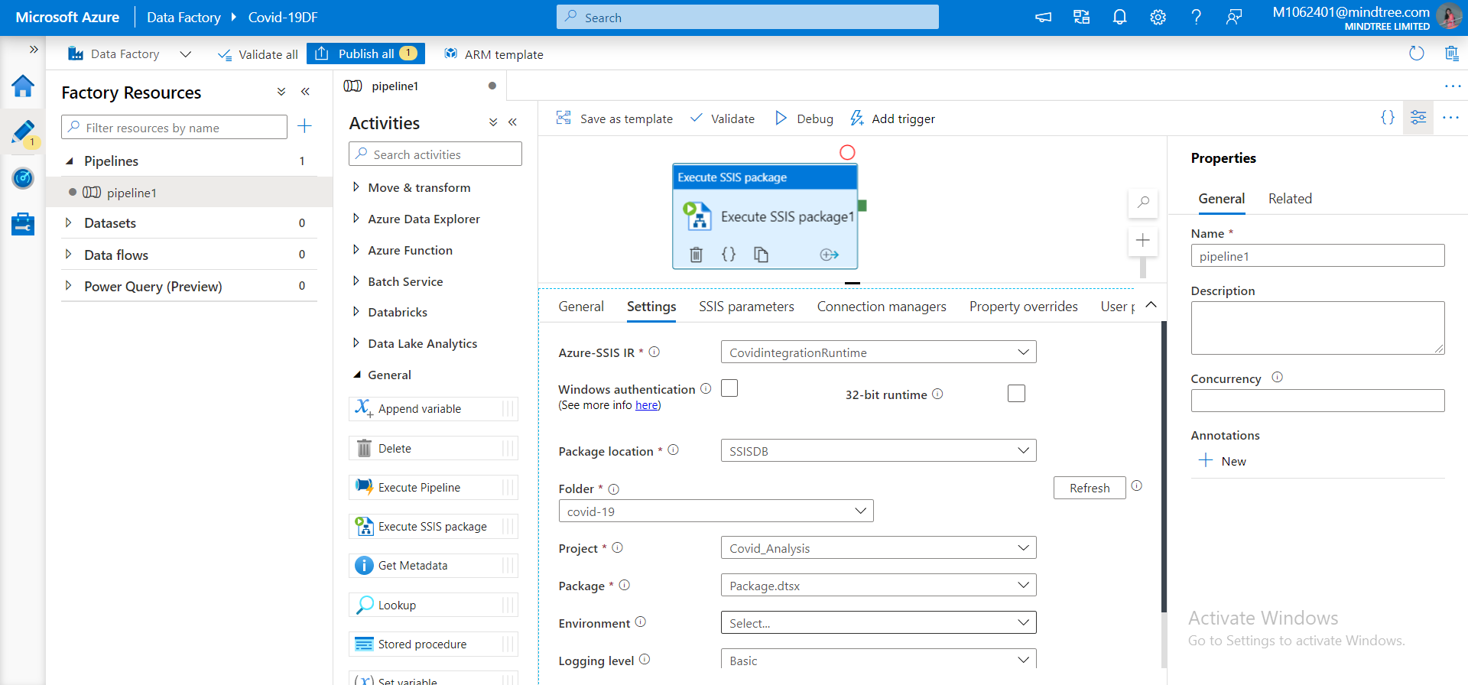
3. Executing the package in Azure datafactory

Slide 8
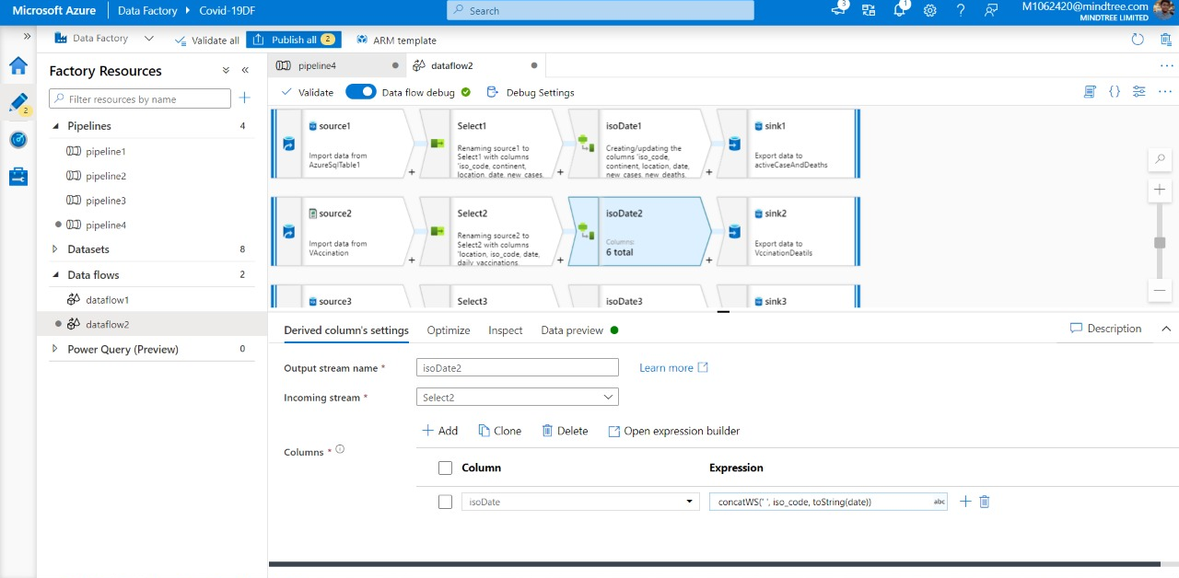
4. Transforming the data as per the requirements and sinking them into new tables using dataflow

Slide 9
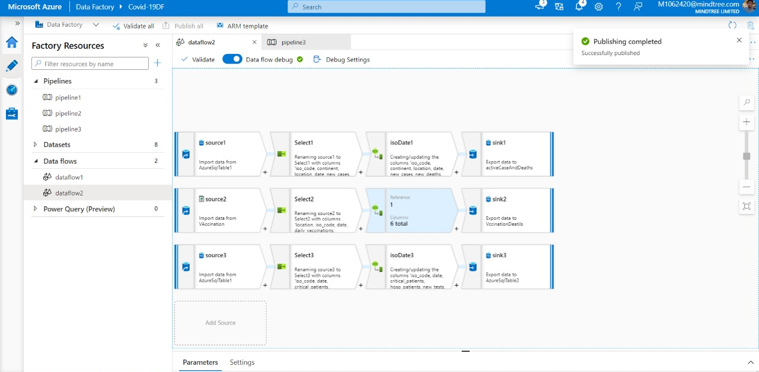
Final dataflow

Slide 10
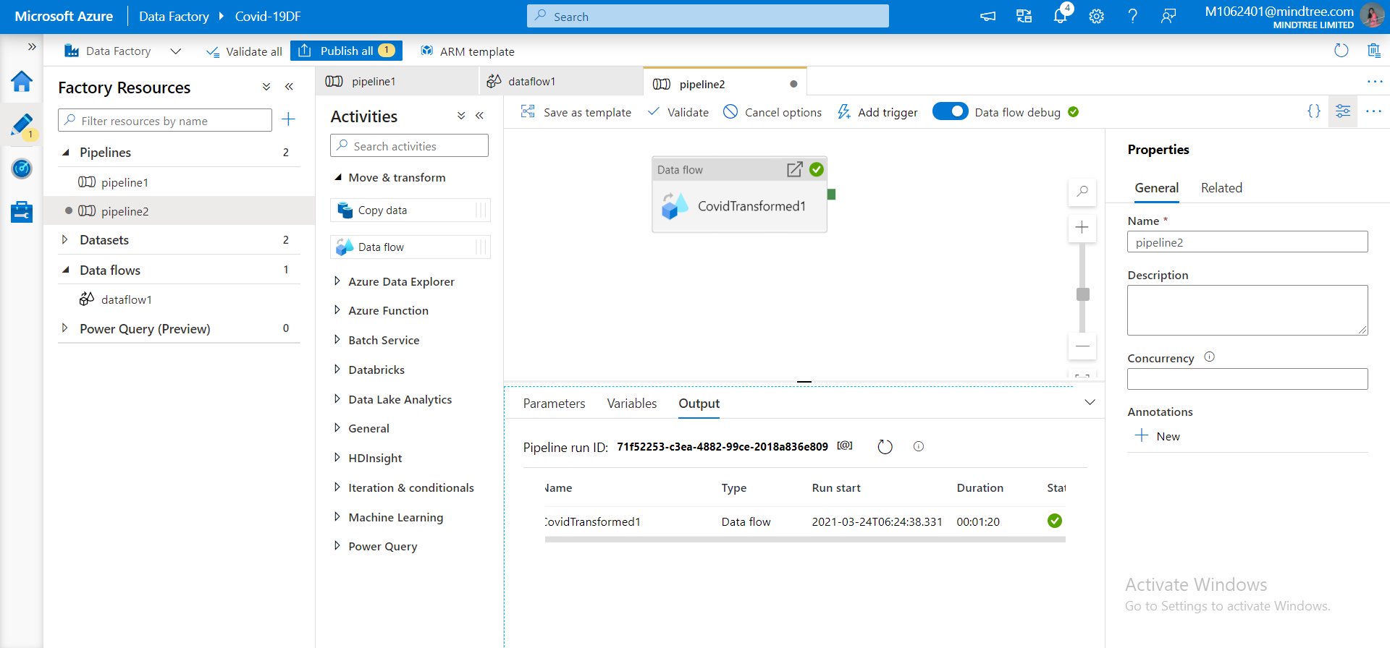
5. Executing dataflow in pipeline

Slide 11
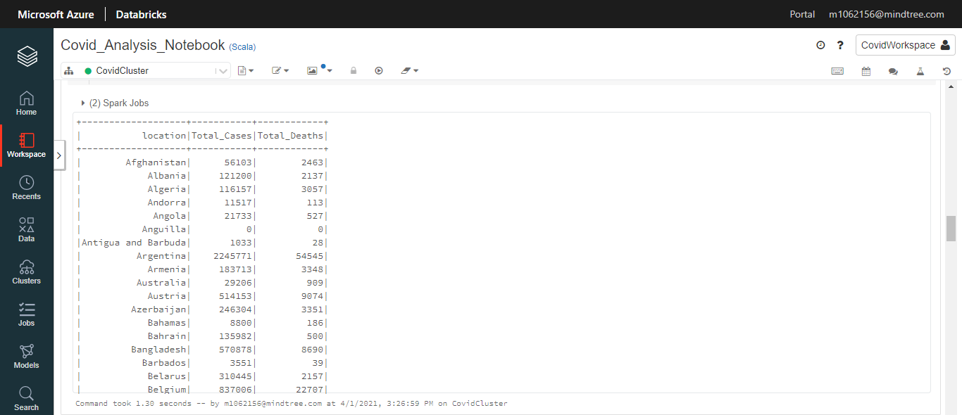
6. Print the total cases and deaths for different countries:
spark.sql("select location,sum(new_cases) AS Total_Cases,sum(new_deaths) AS Total_Deaths from casesAndDeath group By location order by location;").show()

Slide 12

7. Display the confirmed cases of different countries between a certain date:
spark.sql("select location,sum(new_cases) AS Confirmed_Cases from casesAndDeath where date BETWEEN '2020-10-01' AND '2020-11-30' group By location order by location;").show()

Slide 13
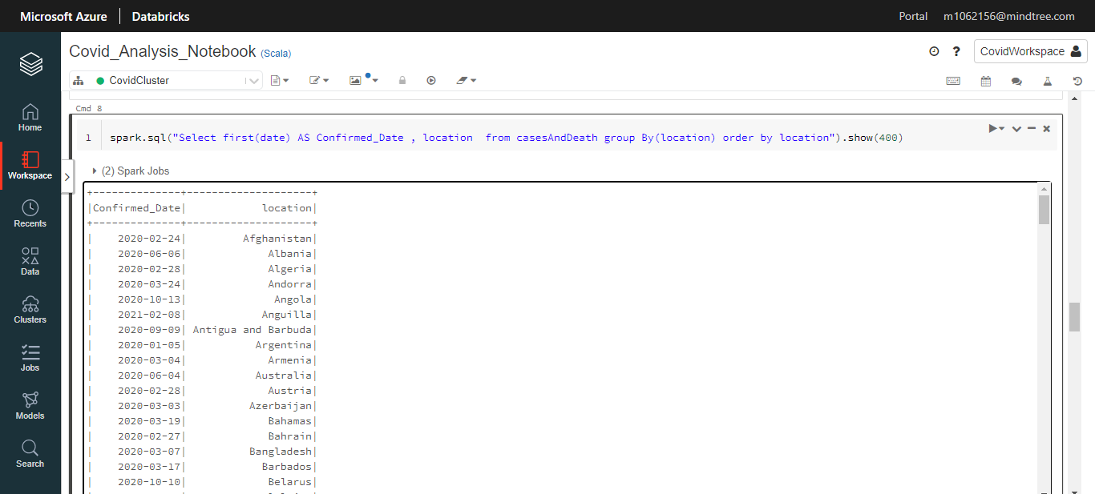
8. Date of first confirmed case in a particular region:
a) spark.sql("Select first(date) AS Confirmed_Date , location from casesAndDeath group By(location) order by location").show(400)

Slide 14
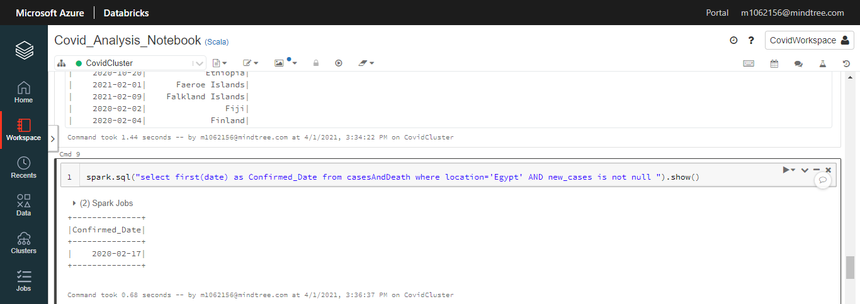
8 b) spark.sql("select first(date) as Confirmed_Date from casesAndDeath where location='Egypt' AND new_cases is not null ").show()

Slide 15
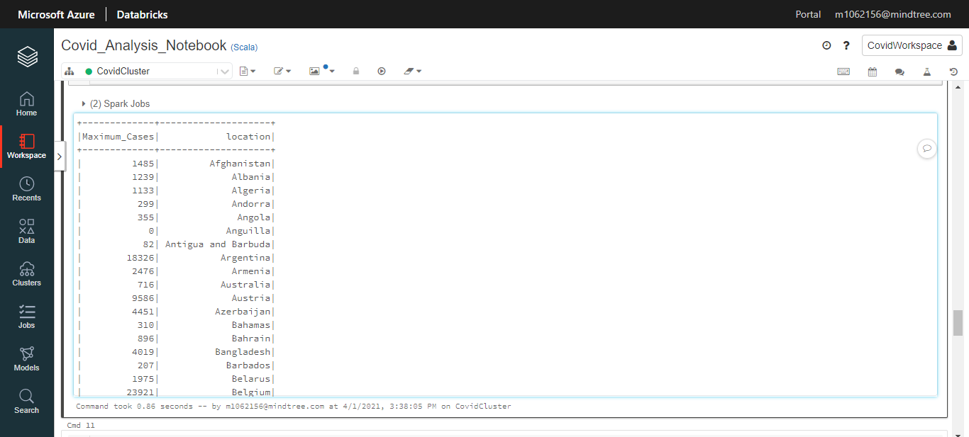
9. Display Maximum no of cases reported in a country
spark.sql("select max(new_cases) as Maximum_Cases,location from casesAndDeath group by location order by location").show(400)

Slide 16
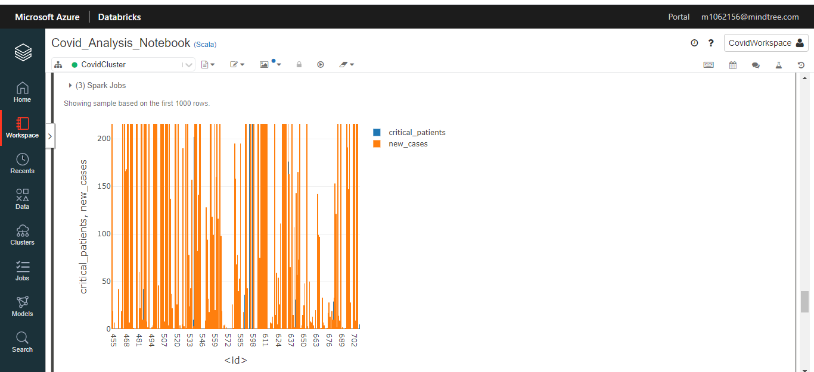
10. Graph of critical cases and confirmed cases in a country
%sql
select casesAndDeath.new_cases,population.critical_patients from casesAndDeath inner join population on casesAndDeath.date=population.date and casesAndDeath.iso_code=population.iso_code

Slide 17
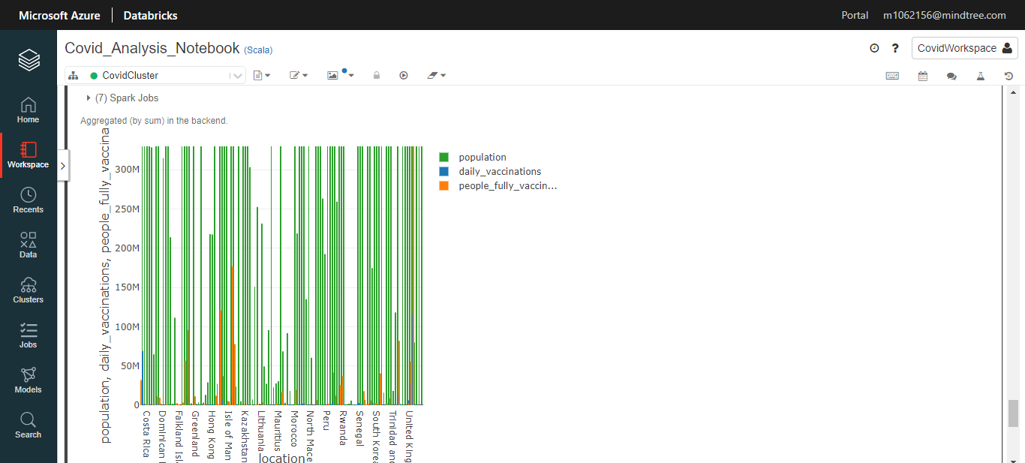
11. Graphical representation of people daily vaccinatied and people who are fully vaccinated
%sql
select v.location,v.daily_vaccinations,v.people_fully_vaccinated,p.population from vaccination v inner join population p on v.date=p.date and v.iso_code=p.iso_code

Slide 18
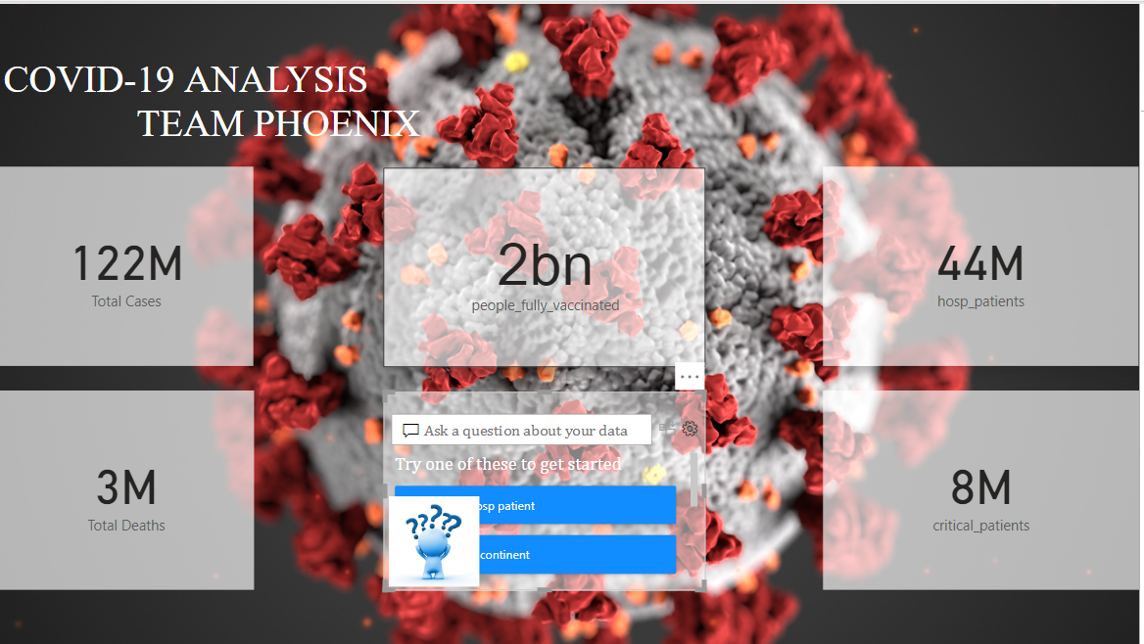
12. Covid 19 Overview

Slide 19
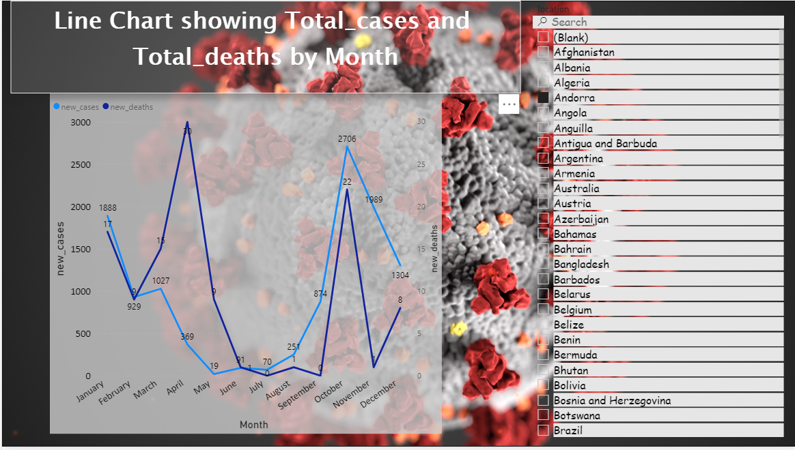
13. Line chart showing Total cases and total deaths by months

Slide 20
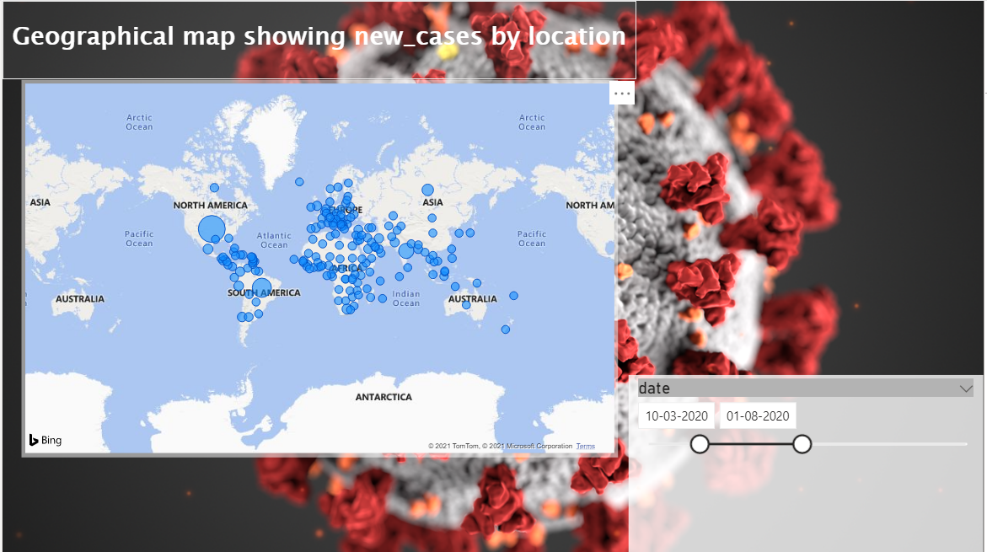
14.Geographical map showing cases in different location between certain dates

Slide 21
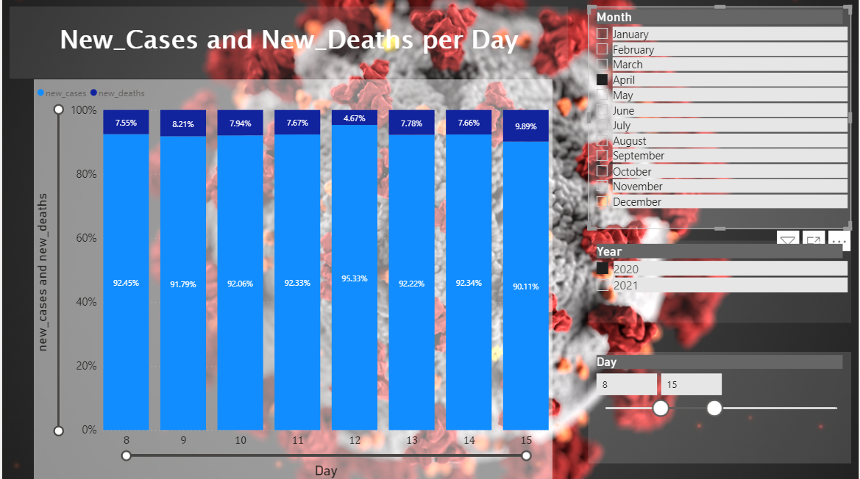
15.Bar Chart showing new cases and deaths per day

Slide 22
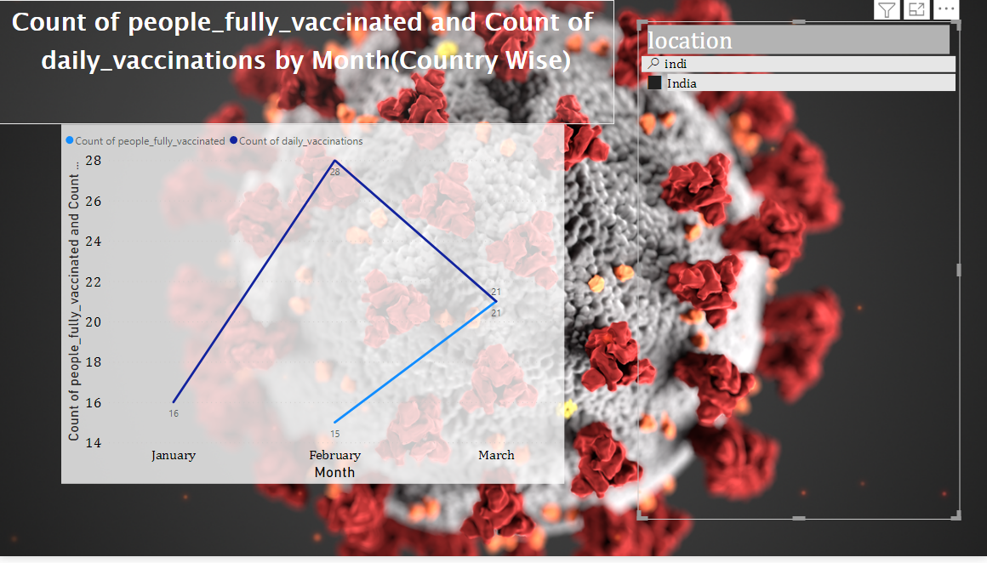
16. Chart showing Vaccination details of a particular country

Slide 23
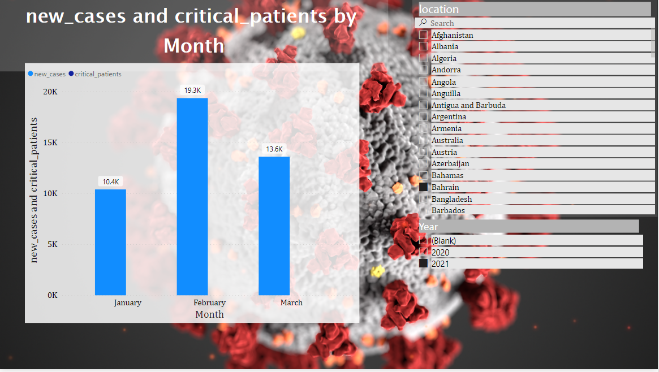
17. Chart showing the total number of cases and critical cases in a particular country according to month and year

Slide 24
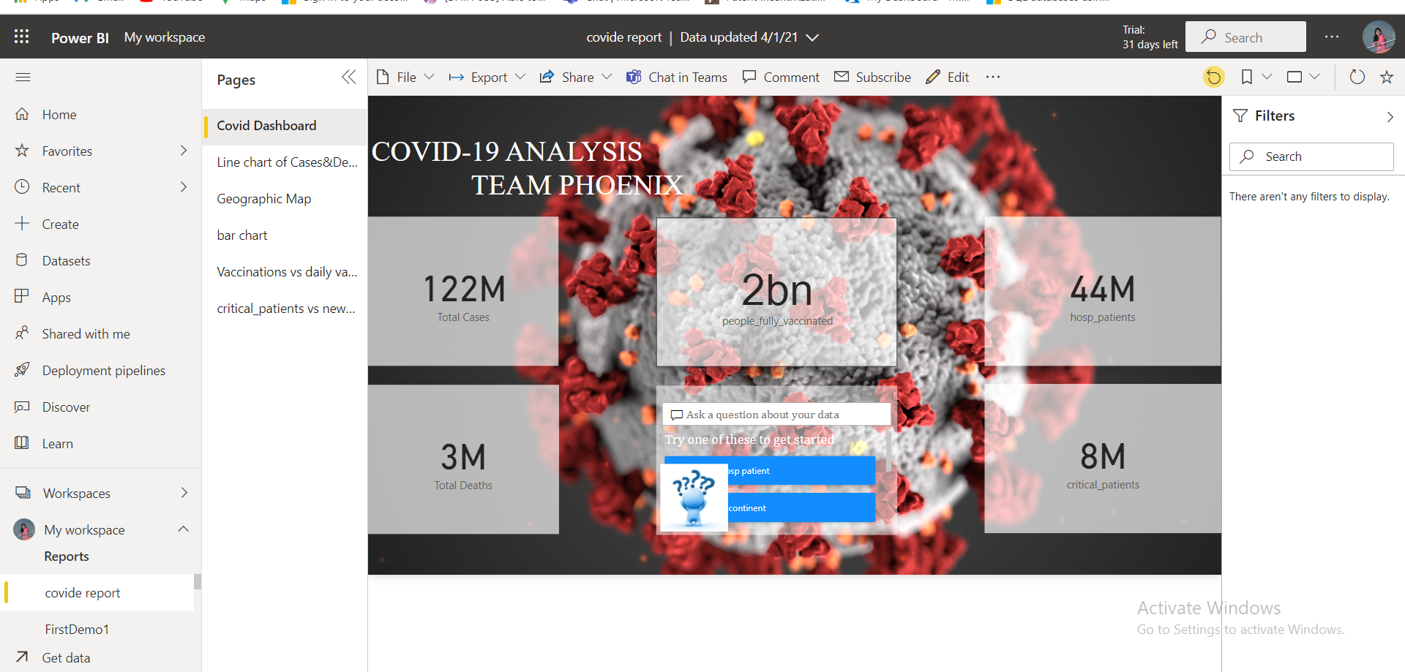
18. Published report

Slide 25
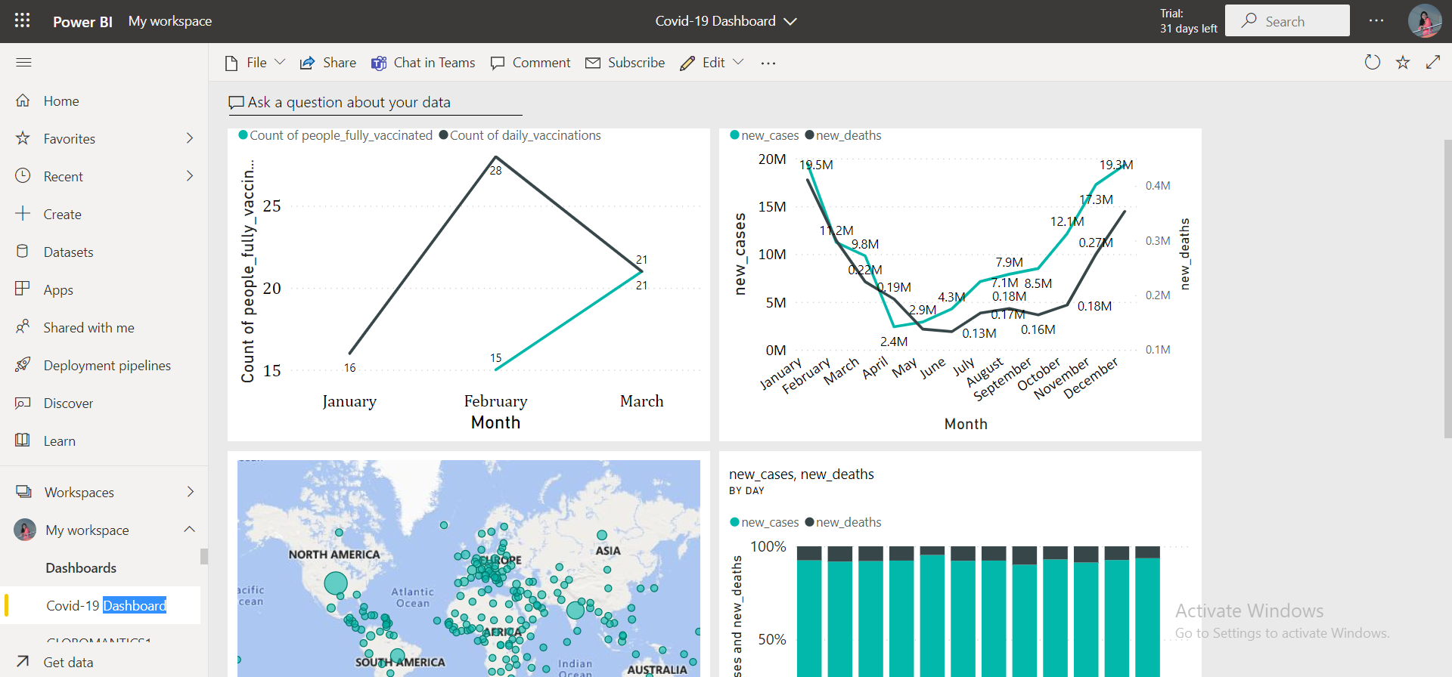
19. Covid 19 Dashboard

